Slide 1
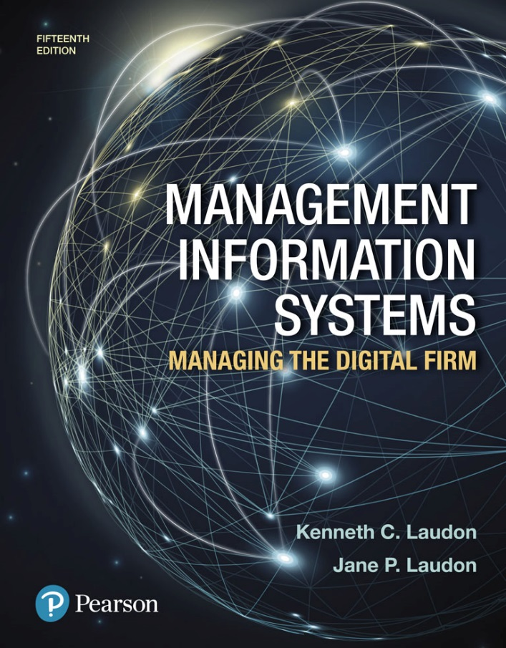
Management Information Systems: Managing the Digital Firm
Fifteenth edition
Chapter 12
Enhancing Decision Making

Slide 2
What Are the Different Types of Decisions, and How Does the Decision Making Process Work? (1 of 2)
Business value of improved decision making
  Improving hundreds of thousands of “small” decisions adds up to large annual value for the business
Types of decisions
  Unstructured: Decision maker must provide judgment, evaluation, and insight to solve problem
  Structured: Repetitive and routine; involve definite procedure for handling so they do not have to be treated each time as new
  Semistructured: Only part of problem has clear-cut answer provided by accepted procedure

Slide 3
What Are the Different Types of decisions, and How Does the Decision Making Process Work? (2 of 2)
Senior managers
  Make many unstructured decisions
Middle managers
  Make more structured decisions but these may include unstructured components
Operational managers and rank and file employees
  Make more structured decisions

Slide 4
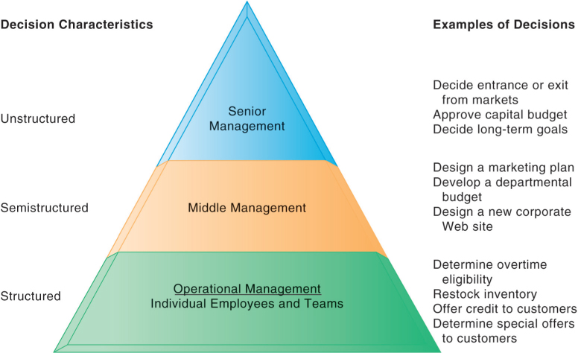
Figure 12.1: Information Requirements of Key Decision-Making Groups in a Firm

Slide 5
The Decision Making Process
Intelligence
  Discovering, identifying, and understanding the problems occurring in the organization
Design
  Identifying and exploring solutions to the problem
Choice
  Choosing among solution alternatives
Implementation
  Making chosen alternative work and continuing to monitor how well solution is working

Slide 6
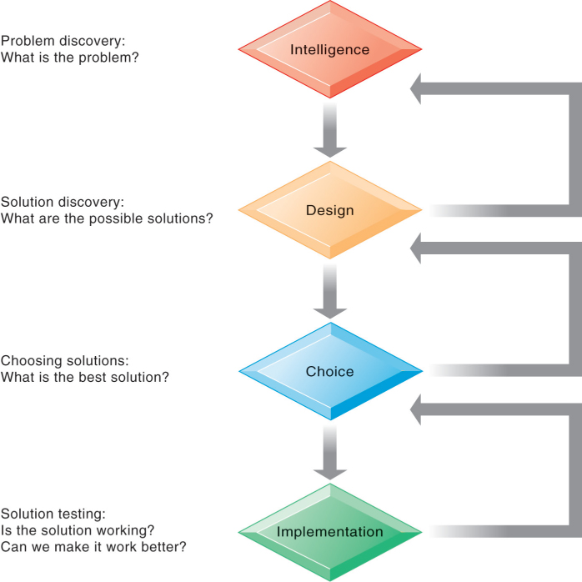
Figure 12.2: Stages In Decision Making

Slide 7
Managerial Roles
Information systems can only assist in some of the roles played by managers
Classical model of management: five functions
  Planning, organizing, coordinating, deciding, and controlling
More contemporary behavioral models
  Actual behavior of managers appears to be less systematic, more informal, less reflective, more reactive, and less well organized than in classical model

Slide 8
Mintzberg’s 10 Managerial Roles
Interpersonal roles
  Figurehead
  Leader
  Liaison
Informational roles
  Nerve center
  Disseminator
  Spokesperson
Decisional roles
  Entrepreneur
  Disturbance handler
  Resource allocator
  Negotiator

Slide 9
Real-World Decision Making
Three main reasons why investments in IT do not always produce positive results
  Information quality
    High-quality decisions require high-quality information
  Management filters
    Managers have selective attention and have variety of biases that reject information that does not conform to prior conceptions
  Organizational inertia and politics
    Strong forces within organizations resist making decisions calling for major change

Slide 10
High-Velocity Automated Decision Making
Made possible through computer algorithms precisely defining steps for a highly structured decision
  Humans taken out of decision
For example: High-speed computer trading programs
  Trades executed in 30 milliseconds
Require safeguards to ensure proper operation and regulation

Slide 11
What Is Business Intelligence?
Business intelligence
  Infrastructure for collecting, storing, analyzing data produced by business
  Databases, data warehouses, data marts
Business analytics
  Tools and techniques for analyzing data
  OLAP, statistics, models, data mining
Business intelligence vendors
  Create business intelligence and analytics purchased by firms

Slide 12
The Business Intelligence Environment
Six elements in the business intelligence environment
  Data from the business environment
  Business intelligence infrastructure
  Business analytics toolset
  Managerial users and methods
  Delivery platform—MIS, DSS, ESS
  User interface
    Data visualization tools

Slide 13
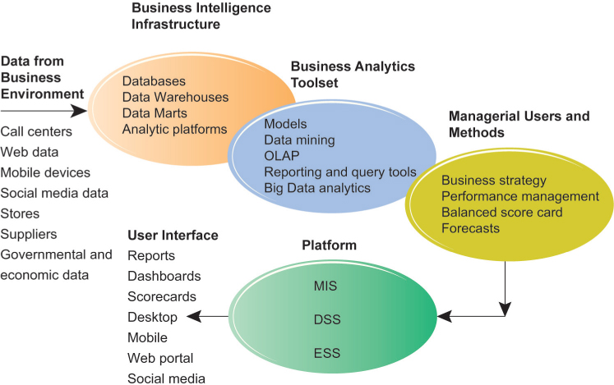
Figure 12.3: Business Intelligence and Analytics for Decision Support

Slide 14
Business Intelligence and Analytics Capabilities
Goal is to deliver accurate real-time information to decision makers
Main analytic functionalities of BI systems
  Production reports
  Parameterized reports
  Dashboards/scorecards
  Ad hoc query/search/report creation
  Drill down
  Forecasts, scenarios, models

Slide 15
Table 12.4: Examples of Business Intelligence Predefined Production Reports
BUSINESS FUNCTIONAL AREA | PRODUCTION REPORTS
Sales | Forecast sales; sales team performance; cross-selling; sales cycle times
Service/call center | Customer satisfaction; service cost; resolution rates; churn rates
Marketing | Campaign effectiveness; loyalty and attrition; market basket analysis
Procurement and support | Direct and indirect spending; off-contract purchases; supplier performance
Supply chain | Backlog; fulfillment status; order cycle time; bill of materials analysis
Financials | General ledger; accounts receivable and payable; cash flow; profitability
Human resources | Employee productivity; compensation; workforce demographics; retention

Slide 16
Predictive Analytics
Uses variety of data, techniques to predict future trends and behavior patterns
  Statistical analysis
  Data mining
  Historical data
  Assumptions
Incorporated into numerous BI applications for sales, marketing, finance, fraud detection, health care
  Credit scoring
  Predicting responses to direct marketing campaigns

Slide 17
Big Data Analytics
Big data: Massive datasets collected from social media, online and in-store customer data, and so on
Help create real-time, personalized shopping experiences for major online retailers
Smart cities
  Public records
  Sensors, location data from smartphones
  Ability to evaluate effect of one service change on system

Slide 18
Operational Intelligence and Analytics
Operational intelligence: Business activity monitoring
Collection and use of data generated by sensors
Internet of Things
  Creating huge streams of data from web activities, sensors, and other monitoring devices
Software for operational intelligence and analytics enable companies to analyze their big data

Slide 19
Location Analytics and Geographic Information Systems
Location analytics
  Ability to gain business insight from the location (geographic) component of data
    Mobile phones
    Sensors, scanning devices
    Map data
Geographic information systems (GIS)
  Ties location-related data to maps
  Example: For helping local governments calculate response times to disasters

Slide 20
Management Strategies for Developing BI and BA Capabilities
One-stop integrated solution
  Hardware firms sell software that run optimally on their hardware
  Makes firm dependent on single vendor
Multiple best-of-breed solution
  Greater flexibility and independence
  Potential difficulties in integration
  Must deal with multiple vendors
All BI and BA systems bring high switching costs

Slide 21
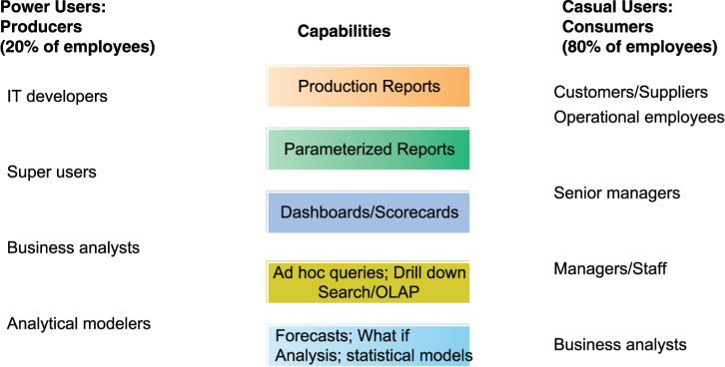
Figure 12.4: Business Intelligence Users

Slide 22
Support for Semistructured Decisions
Decision-support systems
  Support for semistructured decisions
Use mathematical or analytical models
Allow varied types of analysis
  “What-if” analysis
  Sensitivity analysis
  Backward sensitivity analysis
  Multidimensional analysis / OLAP
    For example: pivot tables

Slide 23
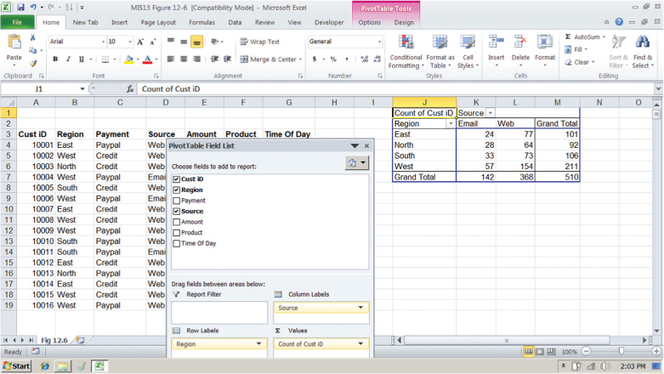
Figure 12.6: A Pivot Table That Examines Customer Regional Distribution and Advertising Source

Slide 24
Decision Support for Senior Management (1 of 2)
ESS: decision support for senior management
  Help executives focus on important performance information
Balanced scorecard method
  Measures outcomes on four dimensions
    Financial
    Business process
    Customer
    Learning and growth
  Key performance indicators (KPIs) measure each dimension

Slide 25
Decision Support for Senior Management (2 of 2)
Business performance management (BPM)
  Translates firm’s strategies (e.g., differentiation, low-cost producer, scope of operation) into operational targets
  KPIs developed to measure progress toward targets
Data for ESS
  Internal data from enterprise applications
  External data such as financial market databases
  Drill-down capabilities

Slide 26
Group Decision-Support Systems (GDSS)
Interactive system to facilitate solution of unstructured problems by group
Specialized tools
  Virtual collaboration rooms
  Software to collect, rank, edit participant ideas and responses
Promotes collaborative atmosphere, anonymity
Cisco’s Collaboration Meeting Rooms Hybrid (CMR)
Skype for Business

Slide 27
End

